Slide 1
QUALYS WEB APPLICATION SCANNING
Lets have a look at Qualys Web Application Scanning

Slide 2
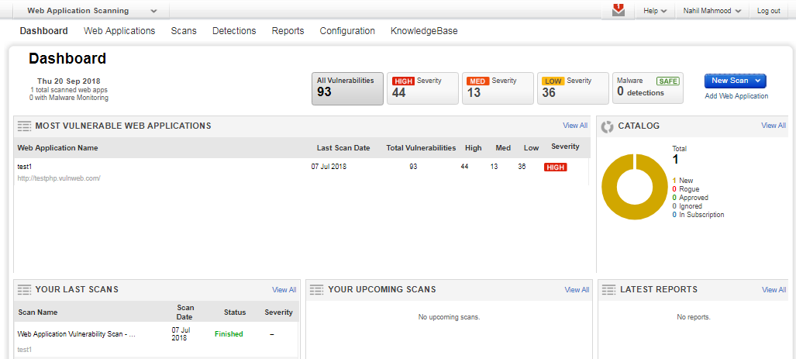
QUALYS WEB APPLICATION SCANNING
DASHBOARD

Slide 3
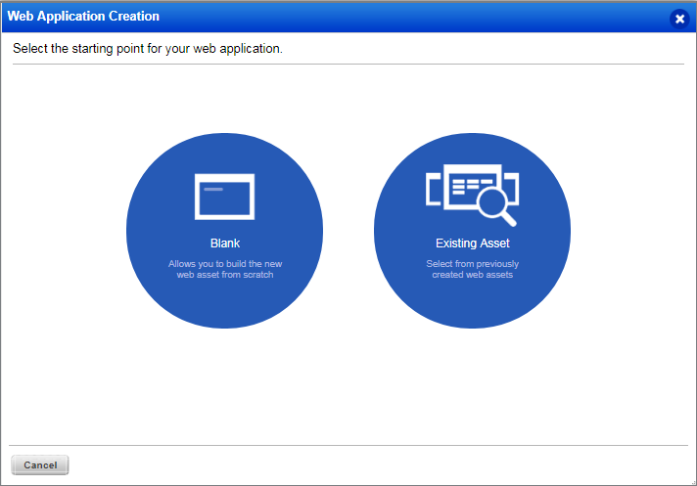
QUALYS WEB APPLICATION SCANNING
CREATION – BLANK OR EXISTING ASSET

Slide 4
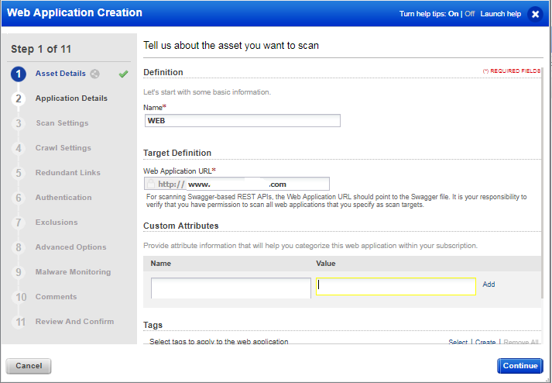
QUALYS WEB APPLICATION SCANNING
ASSET DETAILS

Slide 5
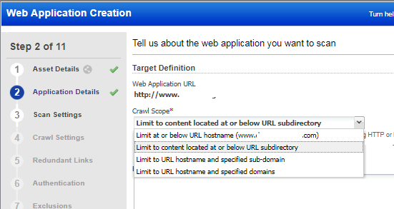
QUALYS WEB APPLICATION SCANNING
CRAWL SCOPE

Slide 6
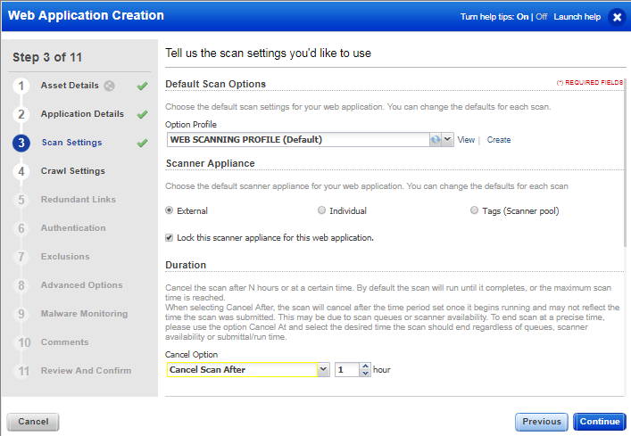
QUALYS WEB APPLICATION SCANNING
SCAN SETTINGS

Slide 7
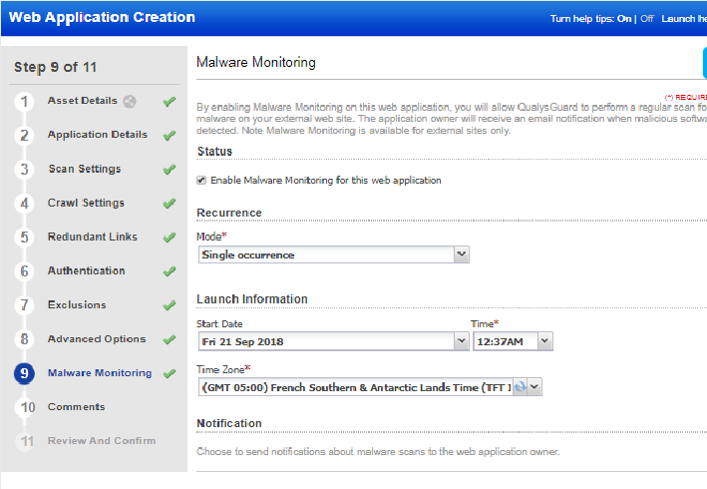
QUALYS WEB APPLICATION SCANNING
MALWARE MONITORING

